Slide 1

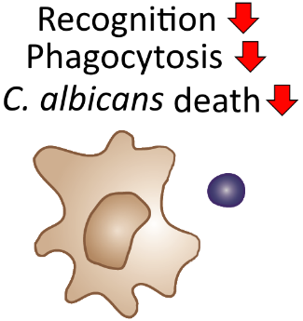
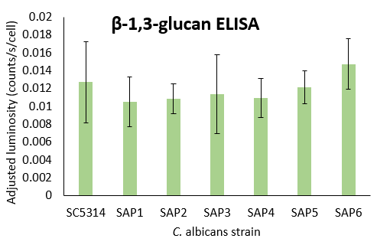

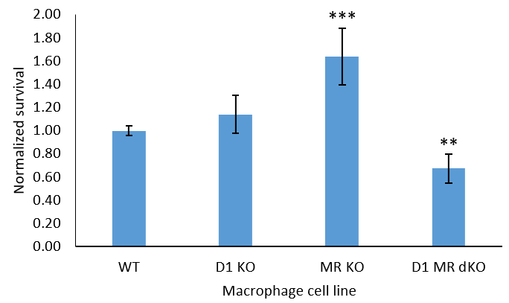



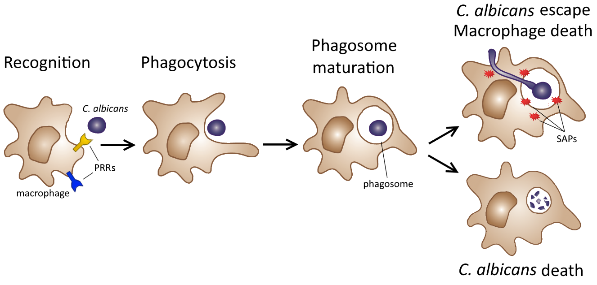
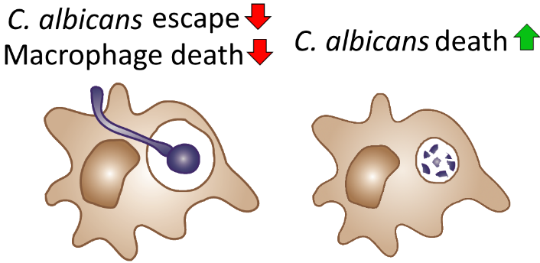
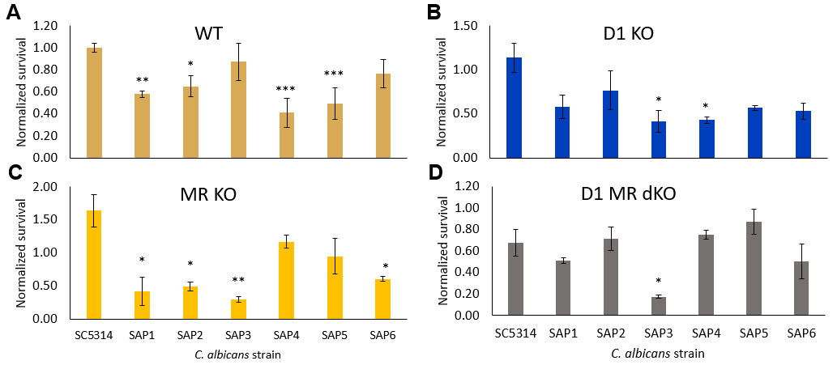

Determining the roles of secreted aspartyl proteases (SAPs) and pattern recognition receptors (PRRs) in host-pathogen interactions
Jeffrey Letourneau, Reeta Rao
Department of Biology and Biotechnology, Worcester Polytechnic Institute, Worcester, MA, USA
Candida albicans is a human pathogen engaged in dynamic interactions with host immune cells
Macrophages lacking Dectin-1 or mannose receptor are less able to eliminate C. albicans
Conclusions
Candida albicans is a yeast present in the microbiomes of healthy individuals, but can cause opportunistic infections and form biofilms on medical devices^{1,2}
  Yeast infections, oral thrush, and bloodstream infections¹
Antifungal resistance is an issue in both well-characterized species like C. albicans and newly discovered species like C. auris²
  Understanding host-pathogen interactions can aid antifungal development
Immune cells such as macrophages use pattern recognition receptors (PRRs) to recognize pathogens^{3,4}
  Macrophages are among the first responders to infection, eliminating pathogens via phagocytosis³
C. albicans may escape phagocytosis by filamentation, killing the macrophage³
  Virulence factors such as secreted aspartyl proteases (SAPs) degrade host proteins, allowing C. albicans to fight back³
PRRs identify conserved structures in microbes called pathogen-associated molecular patterns (PAMPs)⁴
  PAMPs in C. albicans are cell wall components³
  Dectin-1 (D1) recognizes β-glucans³
  Mannose receptor (MR) recognizes mannans³
Knockout of D1 or MR resulted in greater C. albicans survival
  Unexpectedly, significantly decreased survival with D1 MR dKO, possibly due to compensatory mechanisms or interactions between D1, MR, and other PRRs such as TLR2³
All SAP single knockouts exhibited decreased survival for WT, D1 knockout, and MR knockout macrophages
  In WT macrophages, C. albicans lacking SAPs 1, 2, 4, or 5 had significantly reduced survival
  Observed differences are not caused by varying levels of β-1,3-glucan levels in C. albicans strains
  Hypothesis: Macrophages lacking PRRs will be impaired in their ability to recognize and phagocytose pathogens, resulting in increased C. albicans survival compared to survival with WT macrophages.
Macrophage invasion assay is a powerful tool to study host-pathogen interactions
Interactions between C. albicans and host immune cells are dynamic and complex, and much is still unknown about the roles and relationships of the many components involved
Project goal: Determine the roles of macrophage PRRs and C. albicans SAPs in C. albicans survival in vitro by using mutants of both the host and pathogen.
Results:
Assayed WT C. albicans strain SC5314 with WT, D1 knockout, MR knockout, and D1 MR double knockout macrophages
MR knockout showed greatest increase in C. albicans survival
Future experiments and applications
Knocking out secreted aspartyl proteases (SAPs) leads to reduced C. albicans survival
Next experiments:
Time course experiments to determine effect of SAP knockouts at earlier time points after exposure to macrophages
Explore additional PRRs (TLR2, Galectin-3)
Assay C. albicans strains deficient in cell wall components (β-glucans or mannans) against macrophage panel
Assay C. auris isolates against macrophage panel
Long-term goals and applications:
Novel antifungals or vaccines targeting SAPs¹
Understanding how genetic variability in PRRs may alter individual susceptibility to Candida infections³
SAPs are used in adhesion and invasion to digest immune cells, distorting host cell membranes, acquiring nutrients, and evading attack¹
Previous work in our lab has demonstrated that SAP genes are upregulated in live internalized C. albicans and additional studies have indicated that SAPs 4, 5, and 6 are important in surviving phagocytosis¹
Macrophage invasion assay
  Hypothesis: C. albicans lacking SAP genes will exhibit decreased survival, as they will be impaired in their ability to escape phagocytosis.
macrophage
C. albicans
Acknowledgements
Culture macrophages in DMEM + 10% FBS + pen/strep at 37 ºC, 5% CO₂
Plate at 2×10⁶ cells/well
Incubate 1 hour
Culture C. albicans overnight in YPD at 30 ºC
Dilute overnight culture 1:10 and let grow 1-2 hours
Add at 1.33×10⁵ cells/well
I would like to thank the following individuals for their contributions to this project:
My advisor, Dr. Reeta Rao, for providing continuous guidance on this project and in my career as a microbiologist
My lab mates, Toni Delorey, Pablo Reyes-Gutierrez, Meredith Rioux, and Bo Yang, for sharing their expertise and offering assistance on lab techniques
Dr. Stu Levitz and Dr. Chrono Lee at the University of Massachusetts Medical School for providing the macrophage cell lines used in this study
Spin down
Incubate 8 hr
Plate
References
[1] Naglik, J. R., Challacombe, S. J., & Hube, B. (2003). Candida albicans secreted aspartyl proteinases in virulence and pathogenesis. Microbiology and molecular biology reviews, 67(3), 400-428.
[2] Sherry, L., Ramage, G., Kean, R., Borman, A., Johnson, E. M., Richardson, M. D., & Rautemaa-Richardson, R. (2016). Candida auris is highly virulent and resistant, and capable of forming biofilms. Emerging Infectious Diseases.
[3] Netea, M. G., & Maródi, L. (2010). Innate immune mechanisms for recognition and uptake of Candida species. Trends in immunology, 31(9), 346-353.
[4] Takeuchi, O., & Akira, S. (2010). Pattern recognition receptors and inflammation. Cell, 140(6), 805-820.
Incubate plates for 24 hours at 30 ºC and count colony forming units (CFUs)
Calculate percent survival by comparing to no macrophage control
Normalize survival across assays by comparing survival for each sample to survival of WT C. albicans (SC5314) with WT macrophages in that assay
Results:
Assayed each C. albicans SAP mutant with each macrophage cell line
Survival decreases for all six mutants in WT, D1 KO, and MR KO
Notes:
SC5314: WT (n=28), D1 (n=9), MR (n=3), D1 MR dKO (n=6)

